Slide 1
Week 10
Ethnicity and Marginality in Southeast Asia
A case study of the Thais of Kelantan, Malaysia and the Cham of Vietnam.
Notes:
State gives us an identity, and the process of socialisation does that also to reinforce our identities.

Slide 2
Ethnicity
Definition
It is not biological/natural – early anthropologists though ethnicities were linked to skull widths.
It is historically and politically situated. It is fluid.
It is about how we identify with other groups
It is varied and can be changed depending on the context in which it is discussed.
Notes:
How the society understands you through culture. Culture is given or taught rather than born. Most people do not question their ethnicity, and it is viewed as a straightforward topic. The definition of your ethnicity changes due to differences in administrations. Example: not all “Malays” are “Malays” due to differences in language and culture.

Slide 3
The problem of “race”
Connotes biological determinism
A physically distinct “type” of person
Cultural aspects of “racial groups” were often considered by 19th and early 20th social scientists as unchanging and even evolutionary.
It is often a politically-charged concept that empowers national discourses to this day.
Notes:
Huge countries, the differences in identity will work on a much larger scale.

Slide 4
Race latches itself to cultural stereotypes.
Swettenham (1955:139) on the Malays:
“you will wish for no better servant, no more pleasant or cheery companion.”
John Crawford (Governor of Singapore) wrote:
“..the Indian islanders may be pronounced slow of comprehension, but of sound, though narrow judgment…it must be confessed that an Indian islander of the best capacity is unequal, in most respects, to an individual not above mediocrity in a civilised community.”
Notes:
Malays are the best in taking orders. Indians have brains that do not have good judgements. Created the myths that Malays need help; and overgeneralising due to the vast population.

Slide 5
Charles Hirschman (1986) in his article titled:The making of race in colonial Malaya: Political economy and racial ideology,” noted:
…modern “race relations” in Peninsular Malaysia, in the sense of impenetrable group boundaries, were a byproduct of British colonialism of the late nineteenth and early twentieth centuries. Prior to 1850, inter-ethnic relations among Asian populations were marked by cultural stereotypes and occasional hostility, but there were also possibilities for inter-ethnic alliances and acculturation. Direct colonial rule brought European racial theory and constructed a social and economic order structured by “race.” (p. 330)
Notes:
Bringing ethnicity to the political terms in Malaysia.

Slide 6
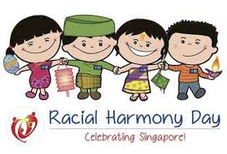
Ethnicity as culture and race as biology have become engrained in the national consciousness of many SEAn states.

Slide 7
Many instances of violence in SEA are associated with ethnic groups who feel “marginalised” in the eyes of the nation, e.g. Moro Muslims in Mindanao (Philippines), Papuans in Irian Jaya (Indonesia), Malays in South Thailand, Kachin/Shan in Myanmar, etc.
Other so-called marginalised ethnic groups may not take up arms but protest in their own ways against what they view to be state encroachment on their identity e.g. “orang asli” groups in Malaysia and land rights.

Slide 8
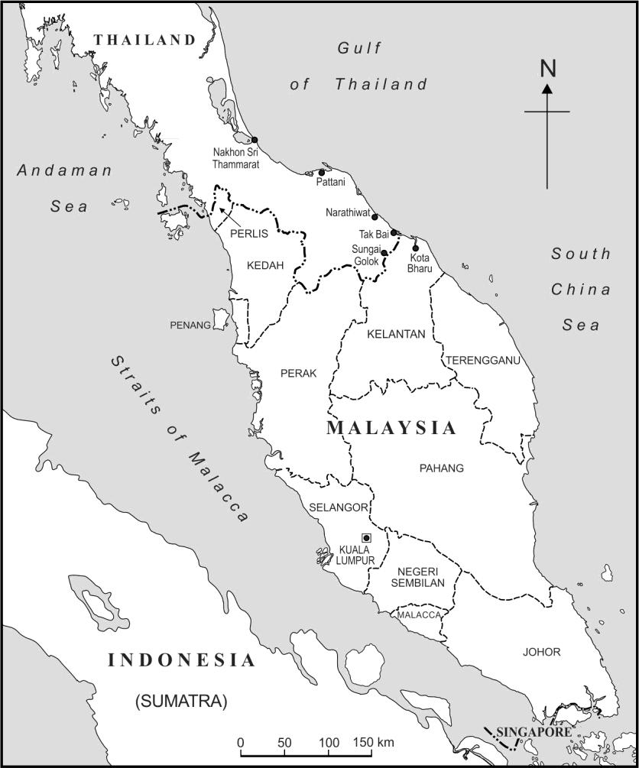
Case Study: The Thai Buddhist Community of Kelantan, Malaysia
Notes:
]

Slide 9
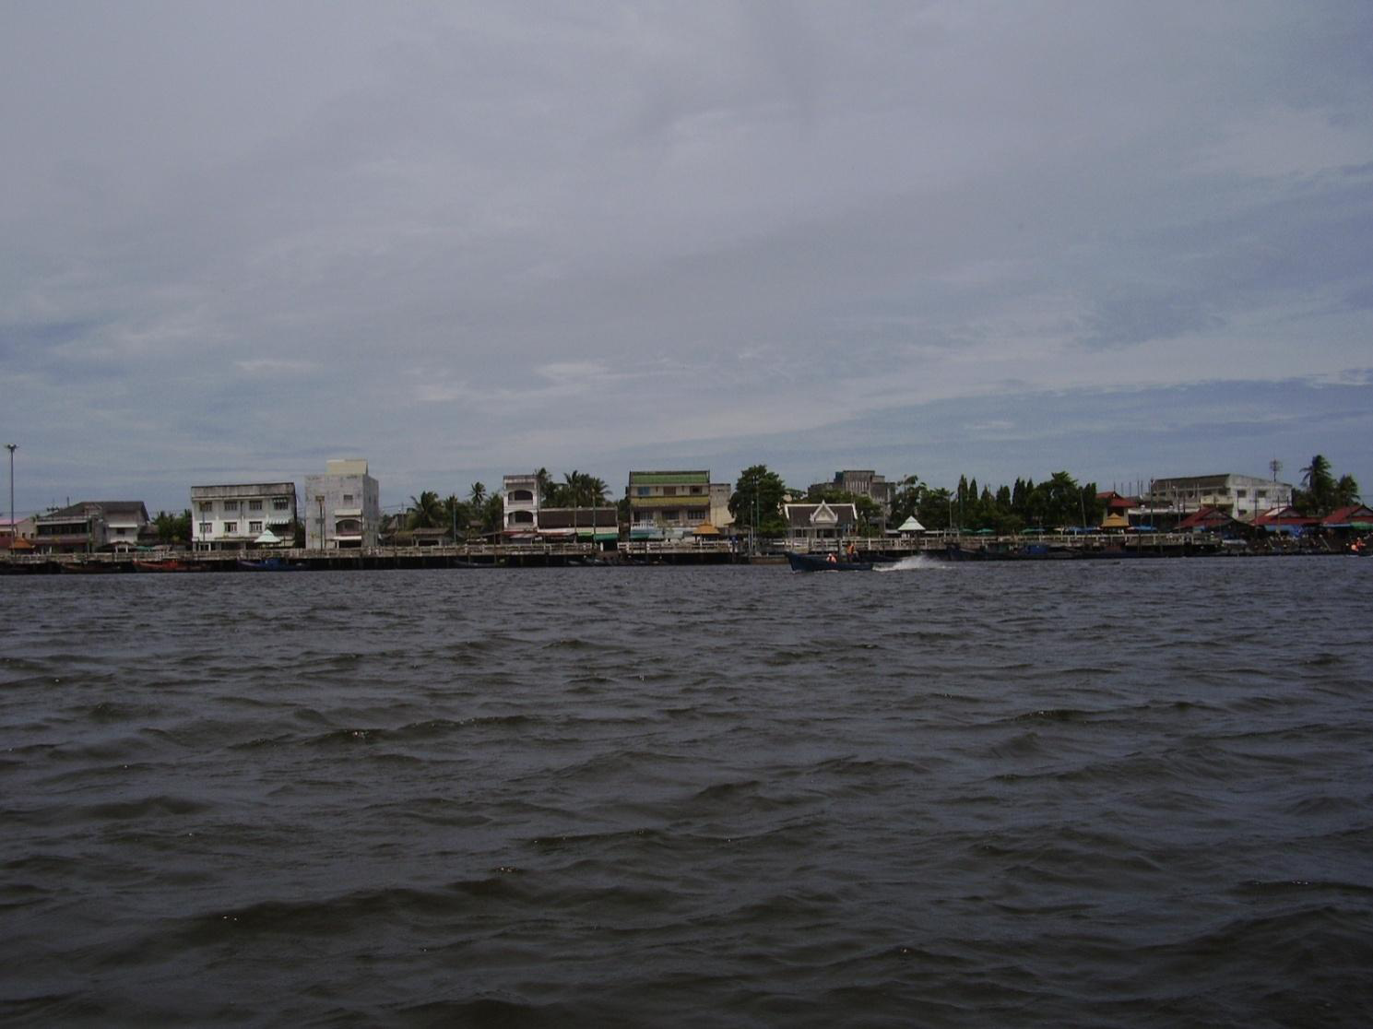
A view from the river

Slide 10
Thai Buddhists in Kelantan
about 10,000 individuals
Mostly Theravada Buddhists. A few have converted to Islam (national politics) often after marriage with Malay Muslims. A number of Malays who married Thais have also secretly converted to Buddhism.
Live in villages to the north of the capital Kota Bharu. 20 Thai Buddhist temples.
Notes:
Note: religion is the same as in Thailand. Kelantan is one of the largest Malay-Muslim state in Malaysia.

Slide 11
The Chinese-Thai relationship (a story of two marginal communities)
Larger and more powerful communities encounter the marginal Thais almost daily.
Economically – Ethnic Chinese from the cities/towns and other parts of Malaysia visit Thai temples for magic and political support. E.g. Malaysia’s MCA donates money to help further “Thai culture” in Kelantan. But this has powerful political undercurrents.
Notes:
Chinese are better off than Thai in Malaysia.

Slide 12
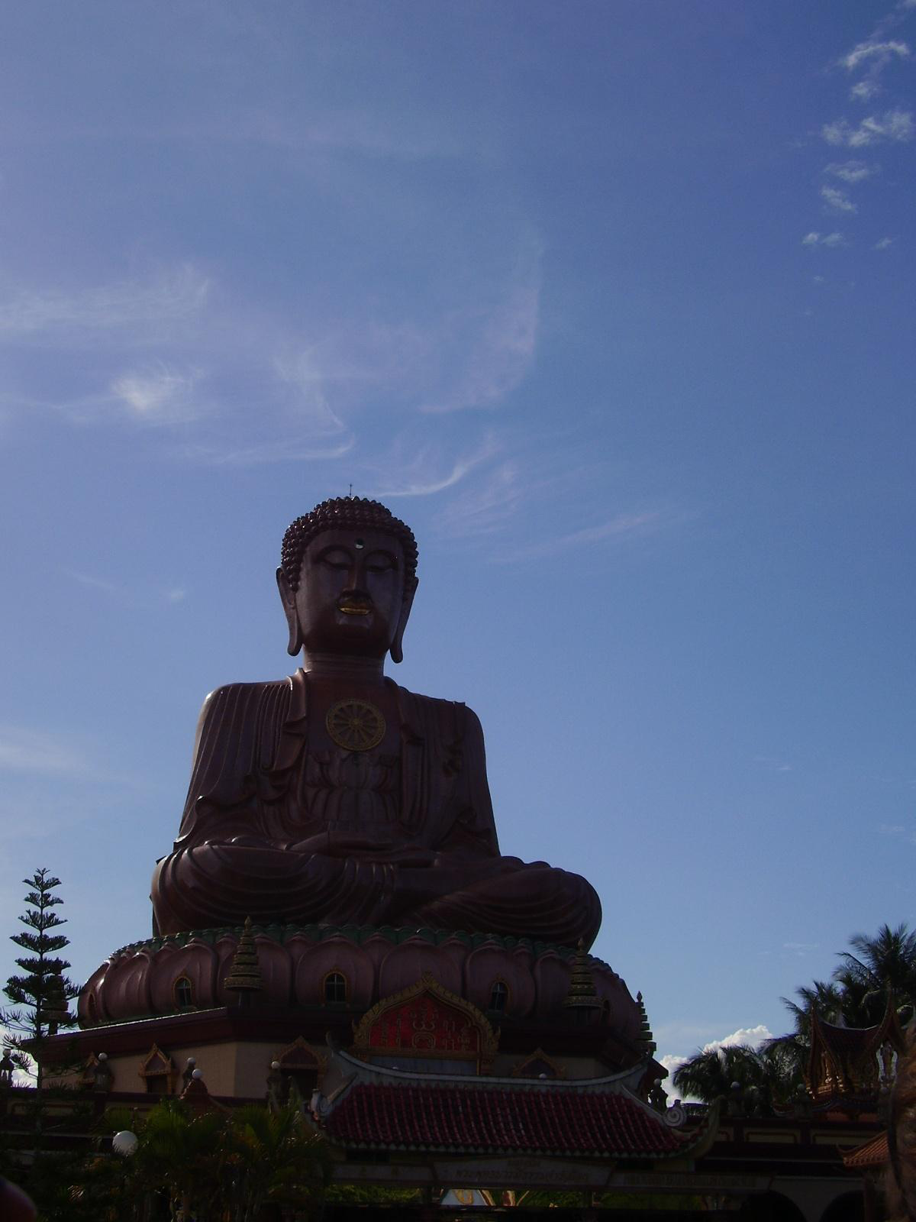
Wat Machimaram’s Buddha – officially unveiled in 2001 at a cost of some 10 million ringgit.
Notes:
Built with Chinese style. In a village with no Chinese people. Chinese people start to visit.
Thai used the donated money to build Thai school to boost Thai culture among the Thai-Malaysians.

Slide 13
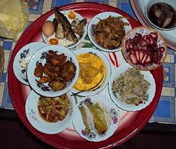
Traditional Kelantanese Chinese meal

Slide 14
Thai-Malay relations – historically strong but currently uncertain
Although Muslims, many Kelantanese Malays have had long and intimate associations with local Thai Buddhists. Eg. Appointment of the chief Buddhist monk lies in the hands of the Sultan.
Malay-based political parties continue to encounter Thais to seek votes during elections. Many Malays also seek out Thai magicians for special services.
Notes:
Malays borrow cutlery and cookery from the Thai temples. However, when September 11 happened, the differences being enforced. Thai in Malaysia insist to watch the 9/11 from Thai TV as the Malaysian network is shewed. Organisers of the Buddhism temple made sure that Police on site is ethically Thai as there is fear. One particular event creates rapture but there are always people who wants to patch up. Idealised Muslim ruler must protect all religions. Thai monks can just walk into the Sultan tempete without security checks.

Slide 15
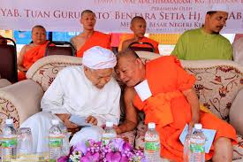
Kelantan’s chief minister and Islamic scholar, Nik Aziz with Thai monks
Notes:
Kelantan says that Muslim laws do not apply to non-Muslims.

Slide 16
Thais and Thailand – Lost Sheep?
•Thailand’s nationalism has historically been constructed along the lines of ethnicity and Buddhism.
Thus, how does the country make sense of politically Malaysians who are also ethnically Thai and Buddhists?
1960- secret policies of land settlements in Narathiwat for Buddhist Thais from Kelantan.
Now- cultural nationalism through informal means e.g. social media/education/television watching.
Notes:
Citizenship with the ability to speak the national language- the standard Malay. Thailand wanted the Malaysian Thais to go back to Thailand to resettlement and always have tried to enculturation. Cooking shows from Thai networks starting to show on Malaysian Thais food which was traditionally not present.

Slide 17
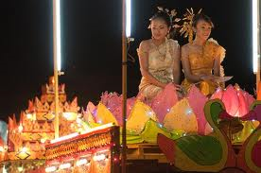
Loy krathong festival in Tumpat, Kelantan

Slide 18
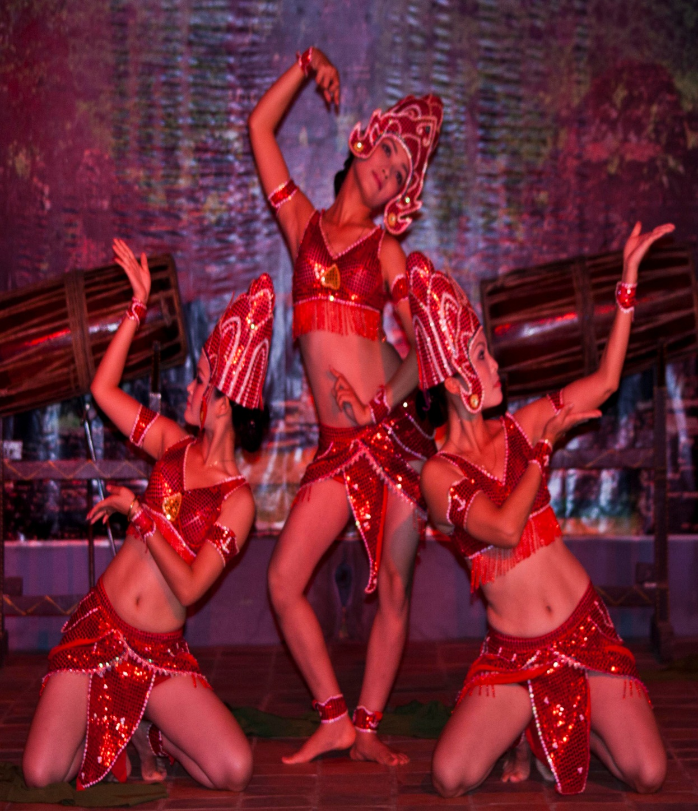
The Cham in Vietnam

Slide 20
The Cham of Vietnam
Austronesian speakers
“Cultural frontier” with Vietnamese, “ethnic frontier” with Khmer
Champa’s absorption by the Vietnamese: The Nam Tien 南进 process
Cham migration/flight to neighboring countries

Slide 21
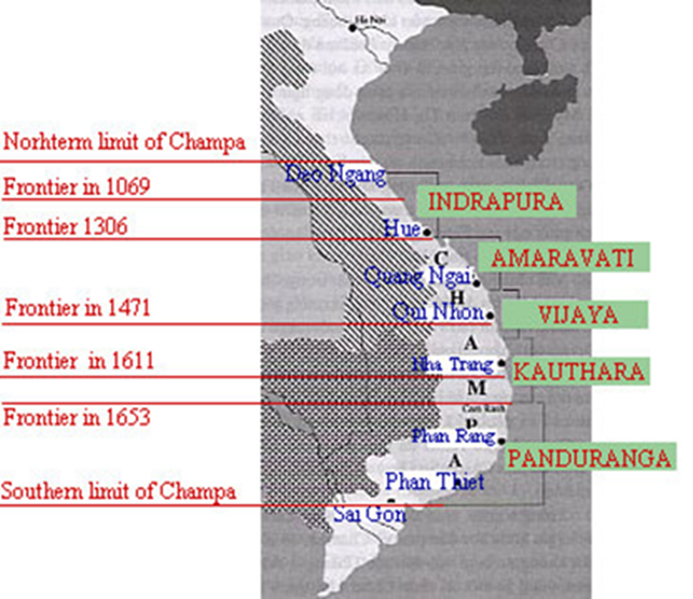

Slide 22
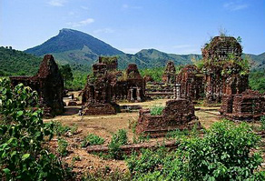

Slide 23
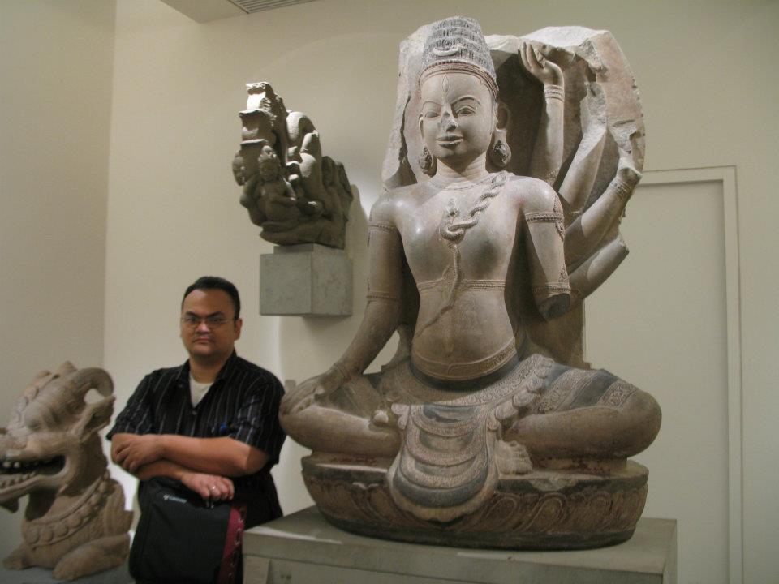
Notes:
Cham has achieved sophiscated art forms

Slide 24
The Cham and Vietnam today
Regarded as one of the major ethnic groups in Vietnam.
Valuable in terms of tourist dollars
Efforts to preserve language, writing and culture
Problems with poverty & social division

Slide 25
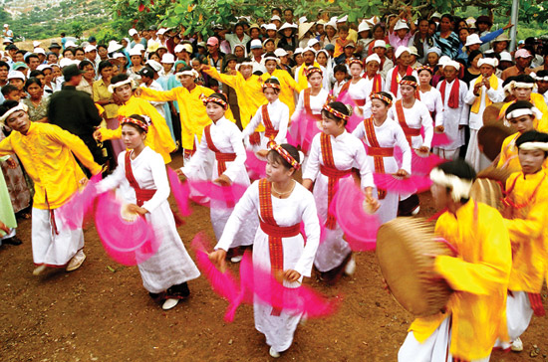
Notes:
Cham define themselves through cultural practices.

Slide 26
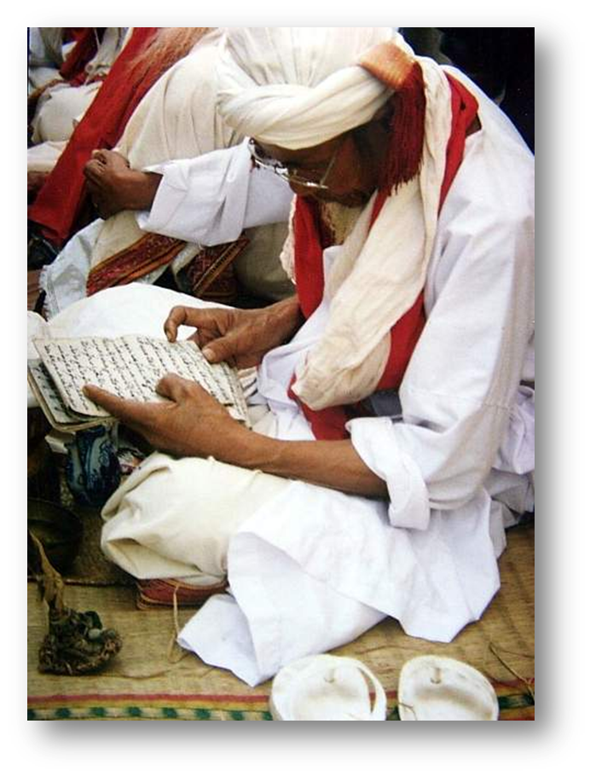

Slide 27
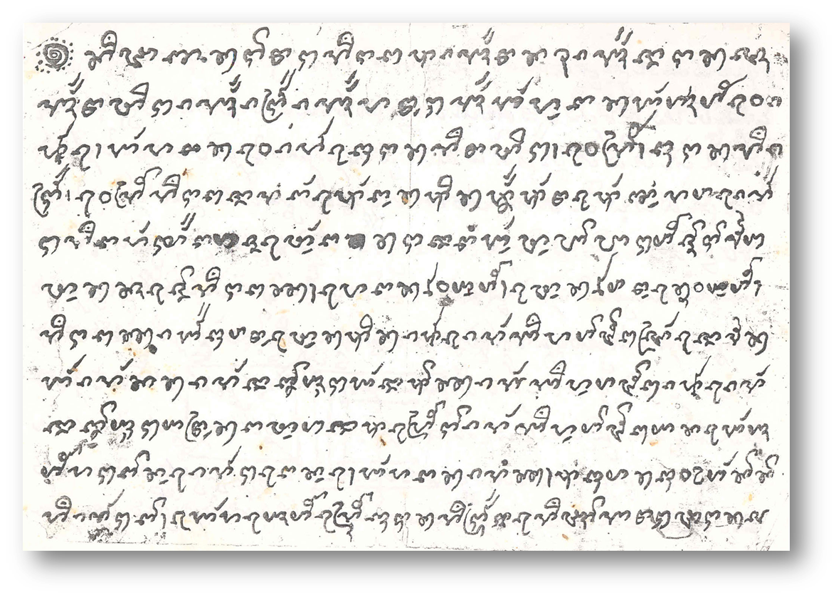

Slide 28
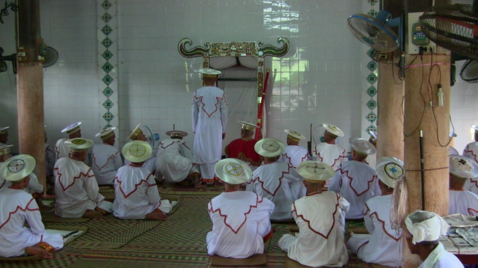
Notes:
Cham religion: mixture animism, Buddhism, taosim, islam.
Worshipping a cham king.

Slide 29
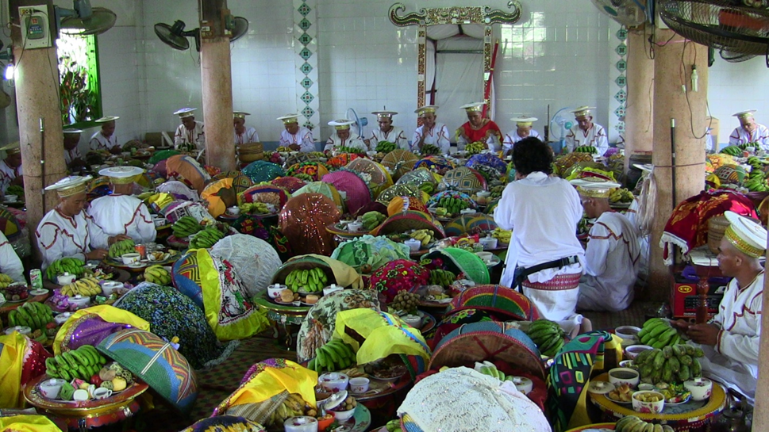

Slide 30
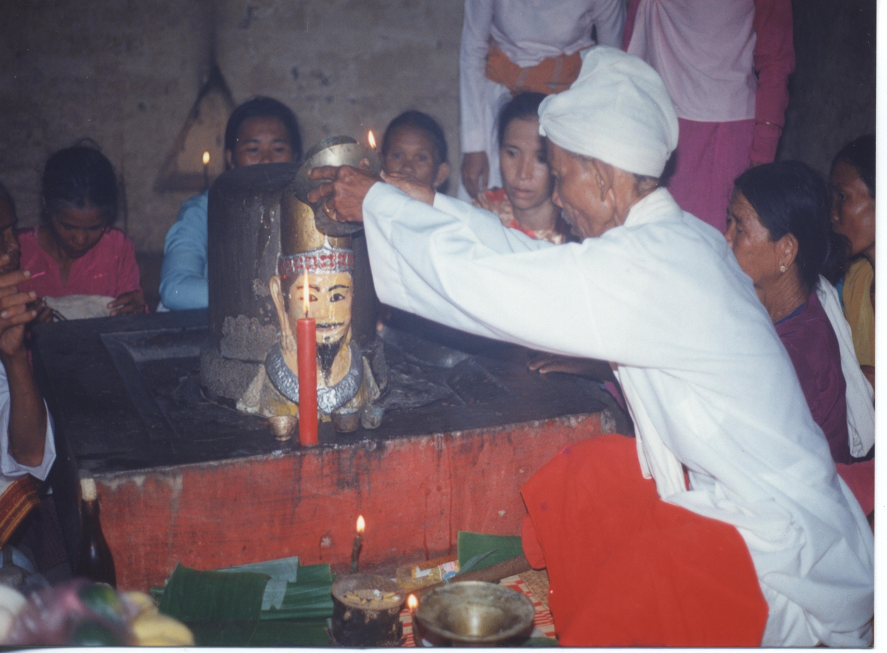

Slide 31
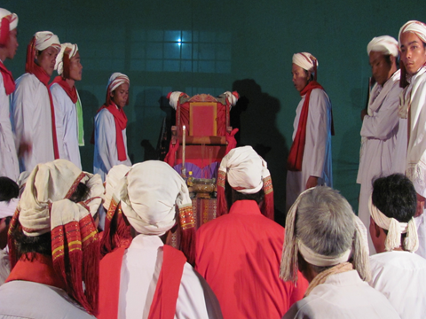
Notes:
Cham can call on the old spirts to sit on the throne..Vietnam hates this as they are living the past which are Cham in nature.

Slide 32
The Cham and Malaysia
Many Cham escaped to Malaysia in 1975.
Malaysian authorities made them recite the shahada (declaration of belief) to distinguish the “Cham Malays” from other groups.
Cham accepted into Malaysia were given schooling, employment and identity as Malaysians.

Slide 33
The Cham in Cambodia
Most are Muslim and many were killed by Pol Pot in 1975
Some Cham in Cambodia only speak Malay and are not distinguishable from the Malays in Malaysia.
However, there are some Cham who continue the “Original Cham ways” from Vietnam.
Notes:
Some Chams do not speak their language. State can project influences on other minority in other states.

Slide 34
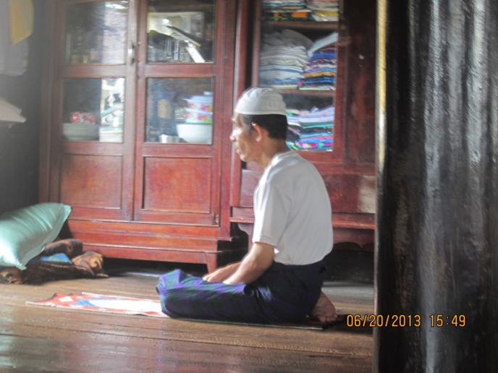

Slide 35
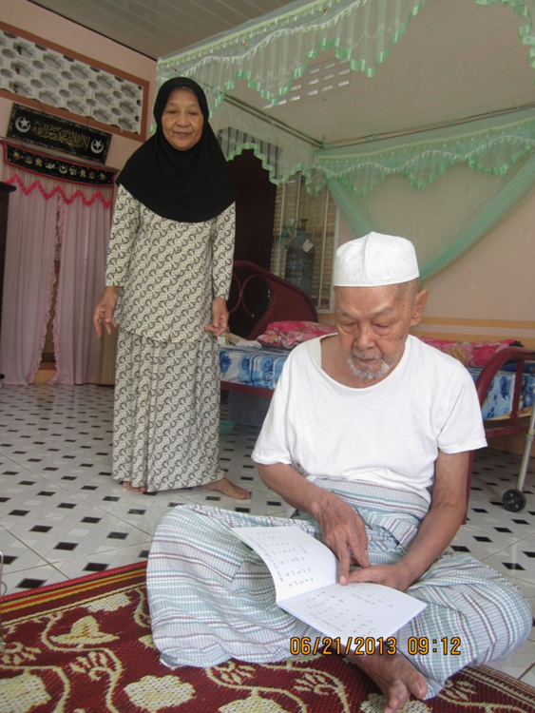

Slide 36
Future of the Cham
Fears that Cham society will face a new period of “Calah-caluen” separation or fragmentation
Survival of traditional knowledge and customs, the very basis of Cham identity
They are very much concerned with economic and cultural survival.
Unity among the various Cham communities are of utmost importance
Notes:
Cham identity is very confusing, and ethnicity in contingent on power, though religion, through history. Cham identity in Vietnam ability to speak the language. Money and economics can change how the Cham view their own identity. Tensions between different interpretations of Cham but there is still harmoniously living as they have a common past.

